Slide 1
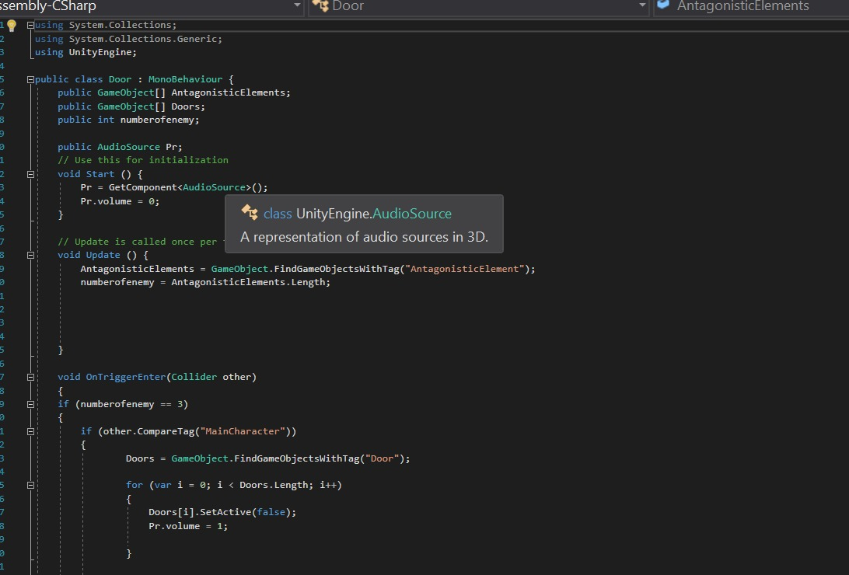
Antagonistic Pathfinding

Slide 2
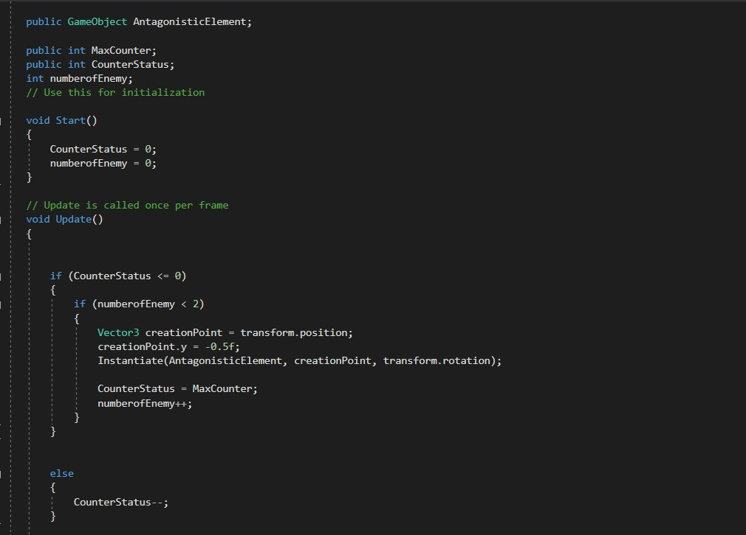
Antagonistic element creator

Slide 3
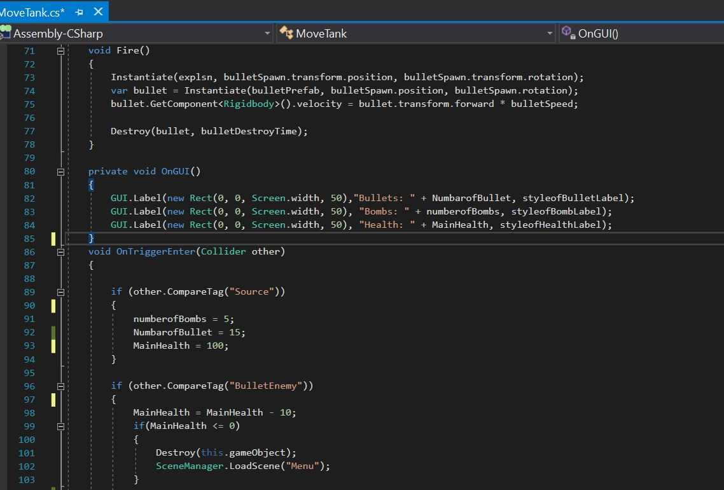
Functions of our tank

Slide 4
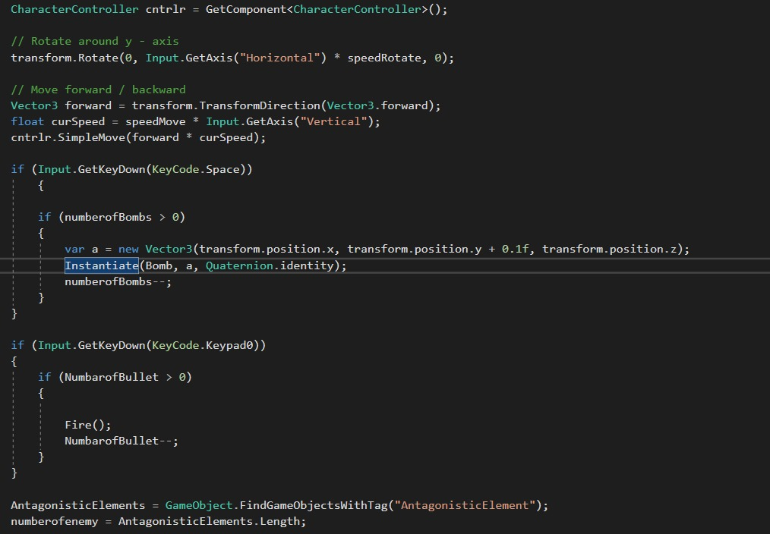

Slide 5
